Slide 1
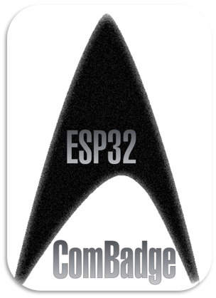
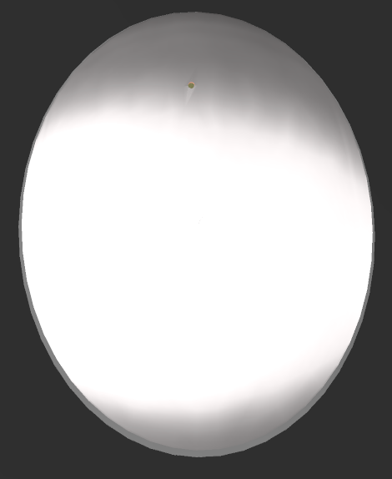
Communications Badge Manual
ComBadge v0.1a

Slide 2
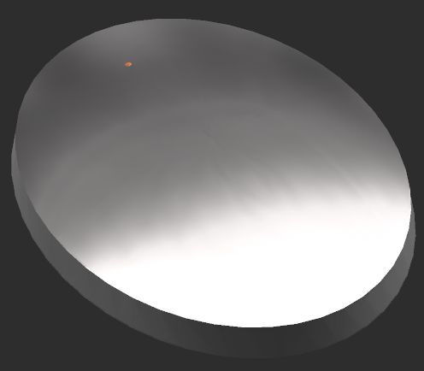
Main Capacitive Touch Panel
Microphone Input
Secondary Capacitive Touch Buttons
To use:
Main Panel:
Tap to activate Listening Mode where the ComBadge will listen for Spoken Commands. - See Commands.
Second Tap exits current Mode.
Secondary Touch Buttons:
Tap to activate corresponding function. - See Secondary Functions.

Slide 3
Commands:
After a Tap on the Capacitive Touch Panel, there will begin a counter of 5 seconds where Listening mode is active.
During Listening Mode speak one of the following to activate its function:
Command | Function
Call <NAME> | Calls Contact with matching name. AI hears command, sends request for Matching BadgeID from local Contacts list, Connects both Badges to Private Channel.
Time, Date etc | AI hears command and Responds with requested information.
Add Contact
RECORD | Records audio from Microphone. Second Tap ends Record Mode.

Slide 4
Secondary Touch Button Functions:
Button | Function
Top Left
Top Right
Bottom Left
Bottom Right

